Slide 1
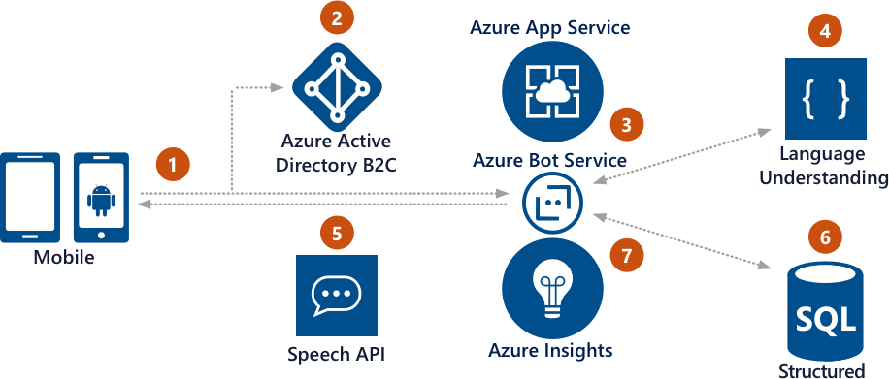


Commerce bot
4. Cognitive Services used to process the natural language request
3. Using the bot in the mobile app, user requests information
Example: Hotel concierge service
2. Using Azure AD B2C, the user authenticates
1. The customer uses the hotel mobile app
5. After the user is happy, mobile app bot updates customer’s reservation
6. Application insights gathers runtime telemetry to help development with bot performance and usage
Key scenarios for bots
Notes:
Commerce scenario: https://docs.microsoft.com/en-us/azure/bot-service/bot-service-scenario-commerce
Commerce sample (v3 SDK): https://github.com/Microsoft/AzureBotServices-scenarios/tree/master/CSharp/Commerce/src
Dixon’s Carphone: https://customers.microsoft.com/en-us/story/dixons-carphone-retail-cognitive-services
Real-time conversations with consumers: https://customers.microsoft.com/en-us/story/targetbase
Facilitating Growth Capital Funding in Africa with bots: https://www.microsoft.com/developerblog/2017/07/19/facilitating-growth-capital-funding-africa-bots/
Here is the logic flow of a Commerce bot that functions as a concierge for a hotel:
The customer uses the hotel mobile app.
Using Azure AD B2C, the user authenticates.
Using the custom Application Bot, user requests information.
Cognitive Services helps process the natural language request.
Response is reviewed by customer who can refine the question using natural conversation.
After the user is happy with the results, the Application Bot updates the customer’s reservation.
Application insights gathers runtime telemetry to help development with bot performance and usage.

